Slide 1
CLASSFUL
ADDRESSING

Slide 2
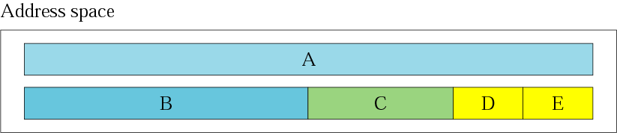
Figure 4-2
Occupation of the address space

Slide 3
In classful addressing the address space is
divided into 5 classes:
A, B, C, D, and E.

Slide 4
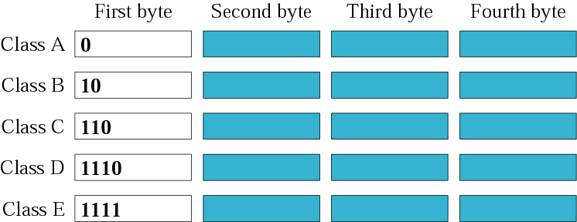
Figure 4-3
Finding the class in binary notation

Slide 5
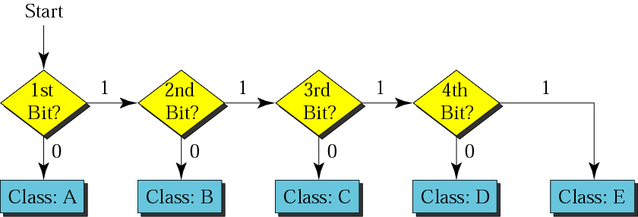
Figure 4-4
Finding the address class

Slide 6
Example
How can we prove that we have 2,147,483,648 addresses in class A?
In class A, only 1 bit defines the class.
The remaining 31 bits are available
for the address. With 31 bits,
we can have 2³¹ or 2,147,483,648 addresses.
Solution

Slide 7
Example
Find the class of the following IP addresses
00000001 00001011 00001011 11101111
11000001 00001011 00001011 11101111
Solution
00000001 00001011 00001011 11101111
1st is 0, hence it is Class A
11000001 00001011 00001011 11101111
1st and 2nd bits are 1, and 3rd bit is 0 hence, Class C

Slide 8
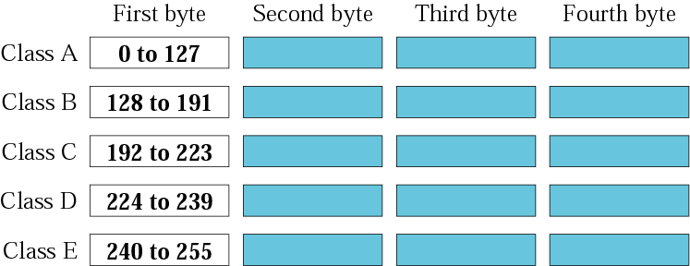
Figure 4-5
Finding the class in decimal notation

Slide 9
Example
Find the class of the following addresses
158.223.1.108
227.13.14.88
Solution
158.223.1.108
1st byte = 158 (128<158<191) class B
227.13.14.88
1st byte = 227 (224<227<239) class D

Slide 10
Example
Find the class of each address:
a. 227.12.14.87
b. 193.14.56.22
c. 14.23.120.8
d. 252.5.15.111
Solution
a. The first byte is 227 (between 224 and 239); the class is D.
b. The first byte is 193 (between 192 and 223); the class is C.
c. The first byte is 14 (between 0 and 127); the class is A.
d. The first byte is 252 (between 240 and 255); the class is E.

Slide 11
Parts of IP Address
In classful addressing, an IP address of class A,B and C is divided into two parts : netid and hostid.
The netid and hostid are of varying lengths, depending on the class of the address.
Netid: The part of an IP address that identifies the network.
Hostid: The part of an IP address that identifies a host in a network.

Slide 12
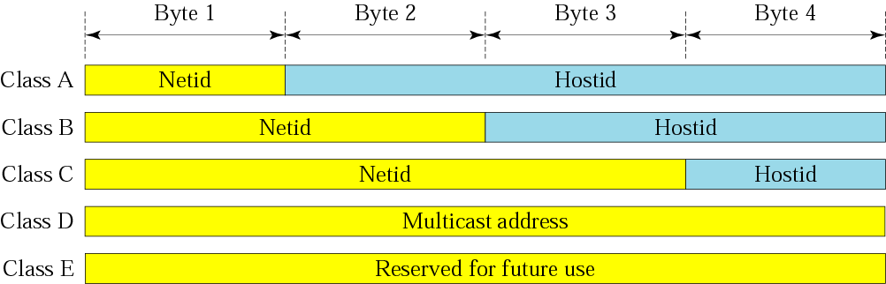
Figure 4-6
Netid and hostid

Slide 13
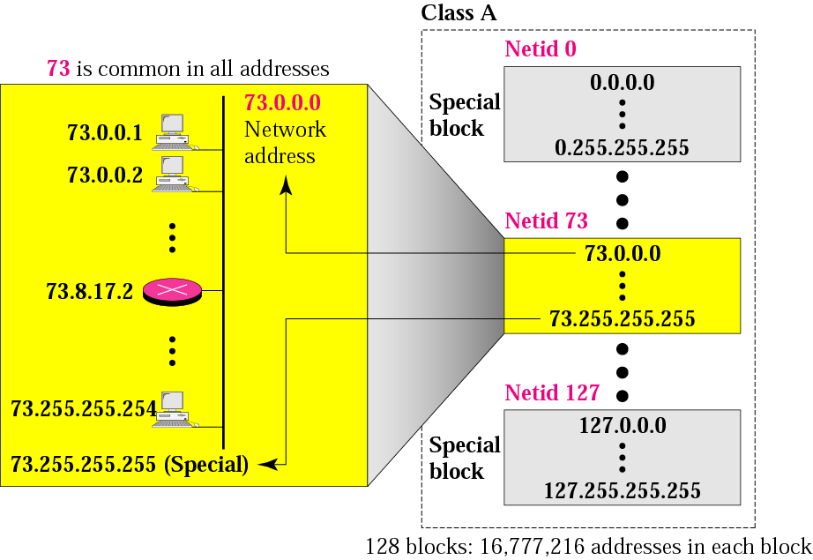
Figure 4-7
Blocks in class A

Slide 14

Millions of class A addresses are wasted.

Slide 15
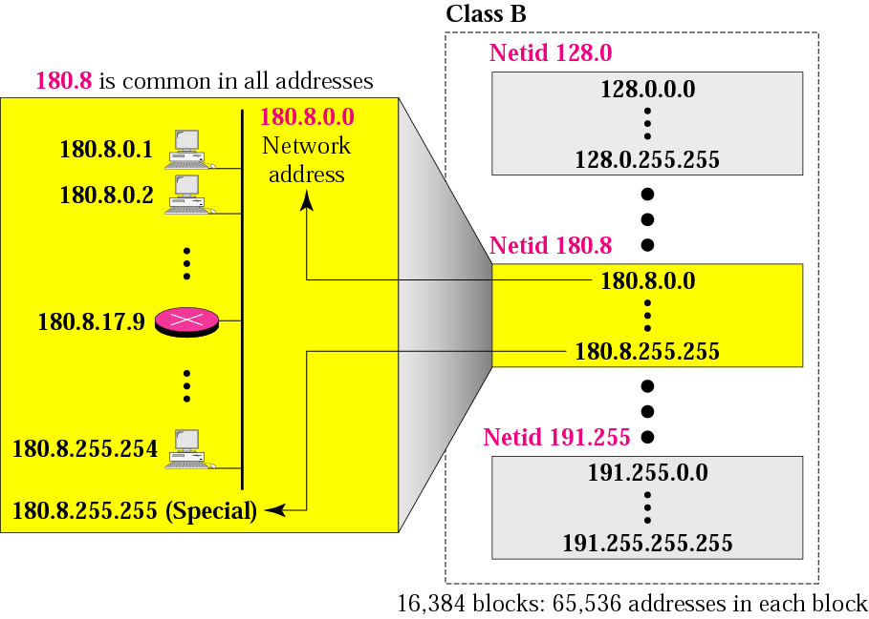
Figure 4-8
Blocks in class B

Slide 16
Many class B addresses are wasted.

Slide 17
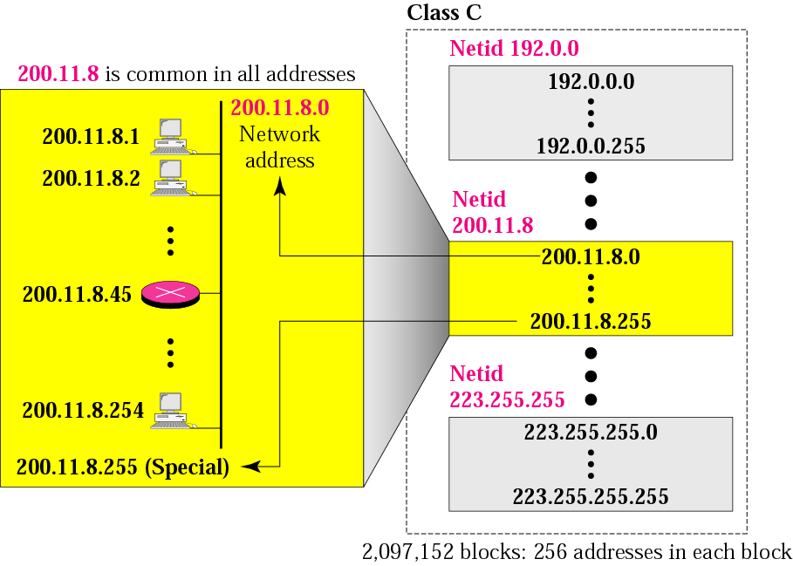
Figure 4-9
Blocks in class C

Slide 18
The number of addresses in a class C block is smaller than the needs of most organizations.

Slide 19
Class D addresses are used for multicasting; there is only one block in this class.

Slide 20
Class E addresses are reserved for special purposes; most of the block is wasted.

Slide 21
Network Addresses
The network address is the first address.
The network address defines the network to the rest of the Internet.
Given the network address, we can find the class of the address, the block, and the range of the addresses in the block

Slide 22
In classful addressing, the network address (the first address in the block) is the one that is assigned to the organization.

Slide 23
Example
Given the network address 132.21.0.0, find the
class, the block, and the range of the addresses
Solution
The 1st byte is between 128 and 191.
Hence, Class B
The block has a netid of 132.21.
The addresses range from
132.21.0.0 to 132.21.255.255.

Slide 24
Mask
A mask is a 32-bit binary number.
The mask is ANDeD with IP address to get
The bloc address (Network address)
Mask And IP address = Block Address

Slide 25
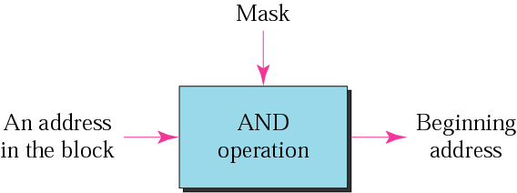
Figure 4-10
Masking concept

Slide 26
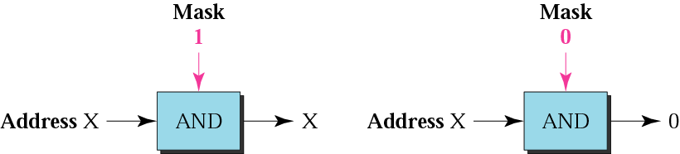
Figure 4-11
AND operation

Slide 27
Default Mask
Class A default mask is 255.0.0.0
Class B default mask is 255.255.0.0
Class C Default mask 255.255.255.0

Slide 28
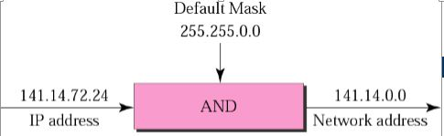
Masking

Slide 29
The network address is the beginning address of each block. It can be found by applying the default mask to any of the addresses in the block (including itself). It retains the netid of the block and sets the hostid to zero.

Slide 30
Subnet mask is used to separate the network address from the host address in IP address. As an IP address is the combination of network address and host address, subnet mask helps us and programs which use IP address in identifying the network portion and the host portion.

Slide 31
Private IP Addresses
Private IP network is an IP network that is not directly connected to the Internet
IP addresses in a private network can be assigned arbitrarily.
Not registered and not guaranteed to be globally unique
Connecting a network using private addresses to the Internet requires the usage of NAT

Slide 32
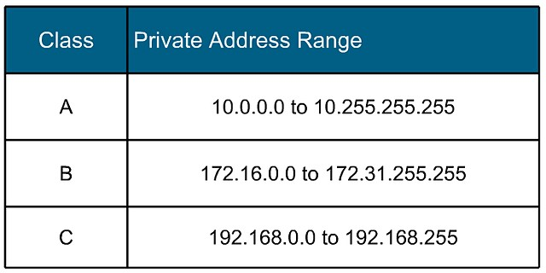
Private IP Ranges

Slide 33
IP versions
IPv4: 32-bit* number Written in Dotted Decimal Notation
205.150.58.7
4 billion different host addresses
IPv6: 128-bit* number: Written in Hex Decimal Notation
2001:0503:0C27:0000:0000:0000:0000:0000
16 billion network addresses

